Slide 1
MA336 Project Final Project
Student name: Madhaviben Kagada
Registration No: 2111898
University of Essex

Slide 2
Flights delay prediction using python
Implementation of random forest classifier & Decision Tree Classifier

Slide 3
introduction
This project is based on the flights data analysis where our main goal is to perform some exploratory data anlaysis on the dataset and then apply data mining algorithms to predict the delay of a flight. The dataset selected is taken from Kaggle which is a public repository for datasets.

Slide 4

How we process.

Slide 5
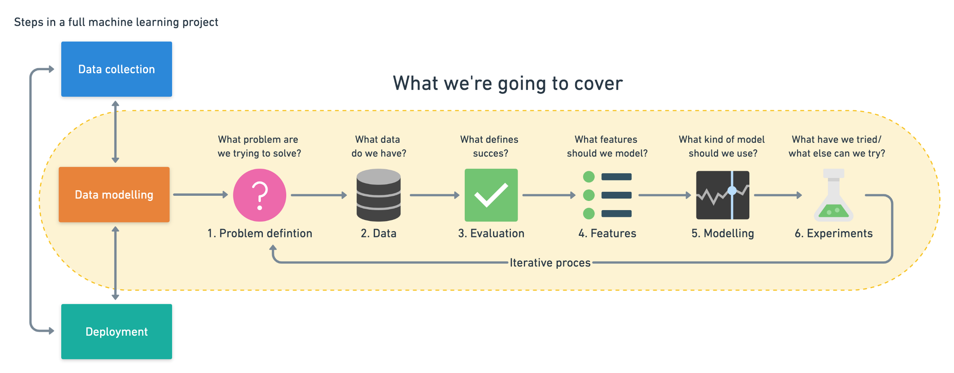

Slide 6
dataset
The dataset consists of a total of 539383 observations and it contains a mix of categorical and numerical /continuous attributes as shown and explained above.

Slide 7
objectives
In order to be sure about what type of analysis and questions will be answered in this project, below is a highlight of what is discussed in upcoming sections:
Do flights which are delayed and not delayed have same or different flight length?
Which airline records highest number of delayed flights?
Which destination airport records highest number of flights delayed?
Build a prediction model to predict the delay.

Slide 8
Methodology
This project follows the below mentioned steps from start till end with an explanation of each step:
Data Preprocessing.
Exploratory Data Analysis.
Data Modelling & Evaluation.
Results Discussion.
Conclusions

Slide 9
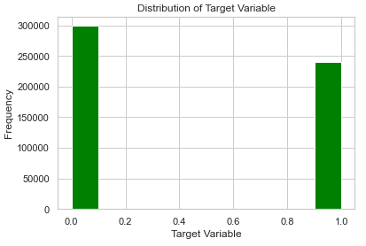
Distribution of target variable
From the histogram we can see that the target variable is completely balanced and there is no imbalancing issues in the dataset.

Slide 10
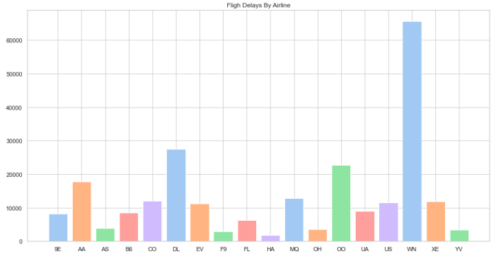
Flight delays by airline
The top three airlines having highest number of flight delays are WN, DL and OO.

Slide 11
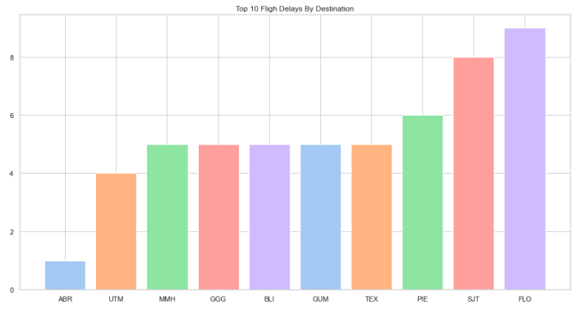
Top 10 flight delays by destination
The top 3 destination airports by number of flights delayed are FLO, SJT and PIE.

Slide 12
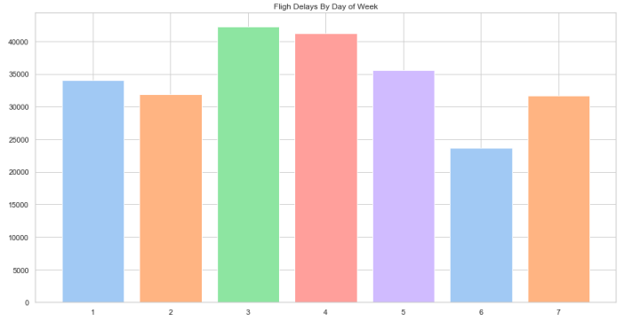
Flight delays by day of week
The day of week having highest number of flight delays are 3 which is Wednesday and the second highest delays are on 4th day of Thursday

Slide 13
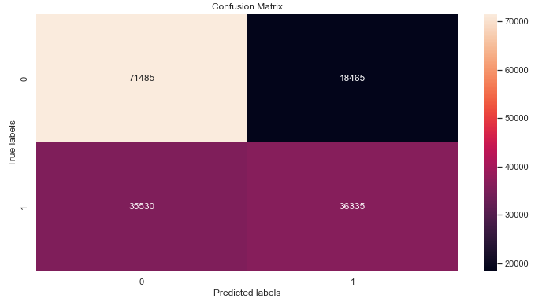
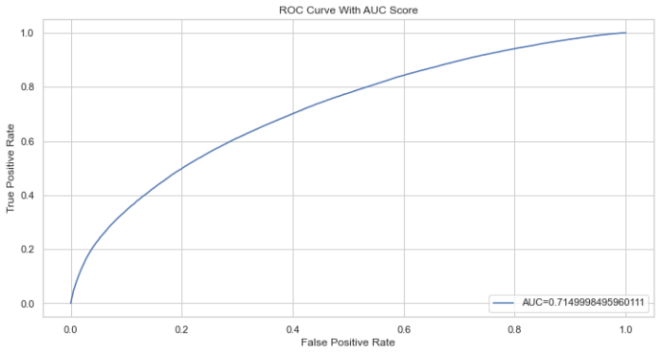
Random forest classifier Evaluation

Slide 14
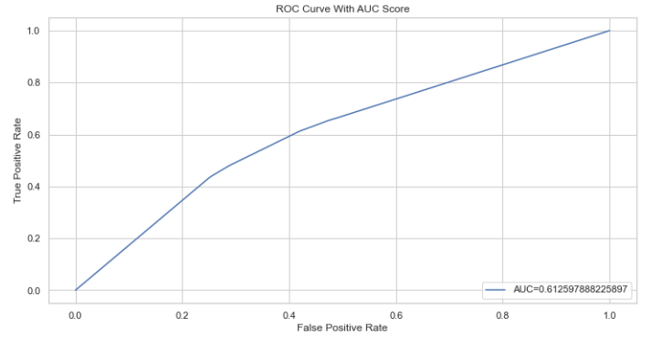
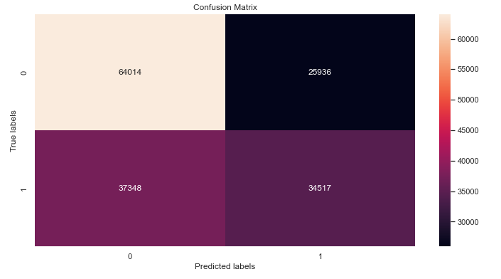
Decision tree evaluation

Slide 15
Results & discussion
Coming towards the result of exploratory data analysis first, it is found that the average length of flight has no effect on flight being delayed or flight being on time. Both have approximately same length. The highest number of flight delays are experienced by WN airline.
If we talk about top 3 airlines by highest number of delays then WN, DL and OO are top 3 airlines which has highest delays. Finally, the destination airport experiencing highest number of delay is FLO.
If we talk about top 3, the FLO, SJT and PIE tops the list. The random forest classifier is trained and tested on training and testing sets.
We found out that the accuracy of our classifier on unseen test dataset is 66% for random forest classifier and 61% for decision tree classifier which could further be improved by applying hyper-parameter tuning techniques.
The ROC curve with and without AUC is also attached and it can be seen that the AUC value for random forest classifier is 71.
This tells us about the area that is being covered by the model. The ROC curve for the decision tree classifier is 61.

Slide 16
conclusions
Concluding this project, we have performed data preprocessing and data cleaning to make our data ready to use and highlighted some points based on which someone can make informed decisions.
More deeper analysis and predictive modelling could be performed given more data about flights.
We found out that WN airline is performing very bad in term of delays, there is always a delay on destination airport FLO and that the classifier could predict accurately up to 66% on unseen data for predicting the delay.
Furthermore, we can highlight which day of week records the highest delays, is time a factor in delays or not and many more.

Slide 17
References:
https://www.mrdbourke.com/a-6-step-field-guide-for-building-machine-learning-projects/
https://scikit-learn.org/stable/tutorial/machine_learning_map/index.html
https://www.kaggle.com/datasets/jimschacko/airlines-dataset-to-predict-a-delay
https://www.kaggle.com/code/fahadhasan/time-series-forecasting

